Slide 1



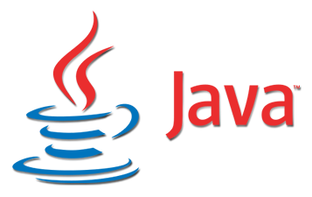
Physical Computing, Java and DevOps on the Raspberry Pi
Scott McCrory – 10/27/2018

Slide 2
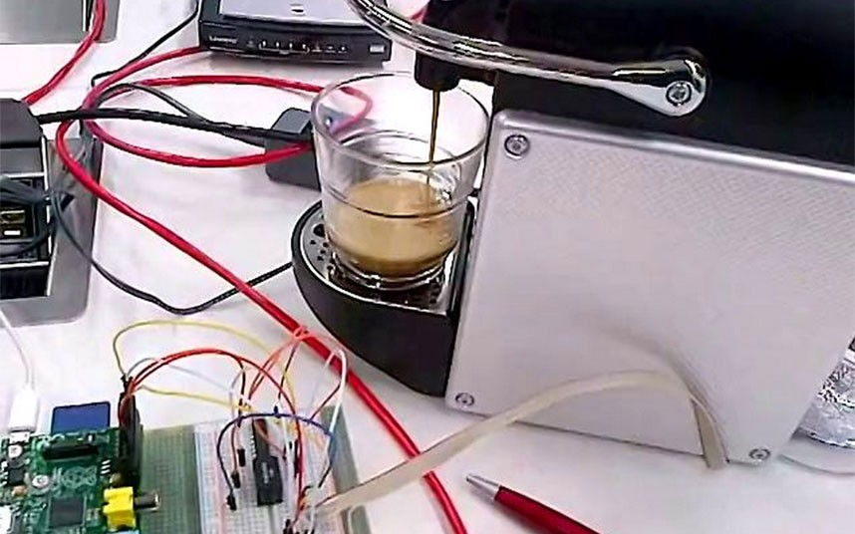
Agenda
Who am I and what this is about?
What is the Raspberry Pi
Why run Java on the Pi
Why play with Jenkins and Docker
Let’s get started
Making the Pi
Installing Java, Jenkins and Docker
Two Examples
Additional Resources

Slide 3

Who am I and what this is about?
I’m Scott McCrory; Sr. I.T. Enterprise Architect at Huntington National Bank; 35 years I.T.; Getting back to my BSEET roots of physical computing
Target Audience: Java developers who want to apply daytime knowledge to Docker, Jenkins, physical computing and low-power Linux-based microcontrollers

Slide 4
Wait a sec – who are YOU?
Who are the Java Developers?
Familiar with Maven?
How about Spring?
Familiar with Jenkins and Continuous Integration?
Familiar with Docker and Containerization?
Familiar with Linux?
Familiar with basic electronics?
It’s OK if you are light on any of these – that’s what this is for!

Slide 5
What is the Raspberry Pi (3 Model B+)?
A microcomputer that runs Linux or Windows 10 for under $40
Did you know that a $40 Pi3B+ runs twice as many MFLOPS as a 1970s $9M Cray 1 supercomputer?
Note: Unlike Arduino, no ADC pins, and the kernel is multitasking

Slide 6
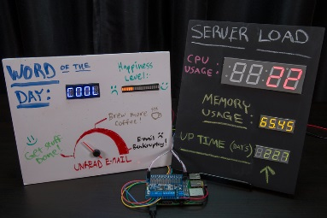
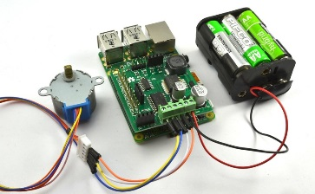
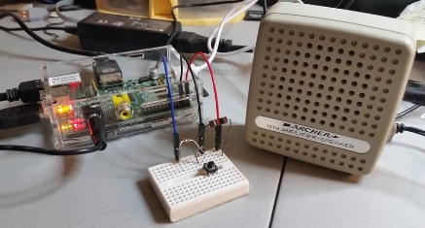
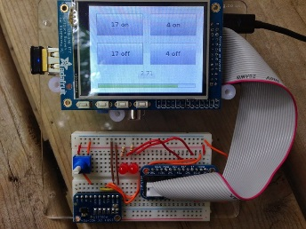

Why Run Java on the Pi?
Well-known and mature language, ecosystem, processes and practices; remains in high demand in the market
Leverage and reinforce what you do at work
Use Eclipse, VS Code, IntelliJ, NetBeans, Maven, Spring Boot and most everything else from your day job
The Pi4j library provides access to the Pi's GPIO pins to interface with electronics!

Slide 7
Why play with Jenkins & Docker on the Pi?
Jenkins
Extremely popular & free “continuous integration” tool to regularly build, test, scan and deploy code
Has a massive library of plugins available
Runs on the Pi just fine!
Docker
Vertical software stack (OS+server) container manager
Containerization is lighter, faster and more scalable than virtualization, with only small decreases in isolation
Docker is awesome during development, even better for PROD
Runs on the Pi just fine!

Slide 8
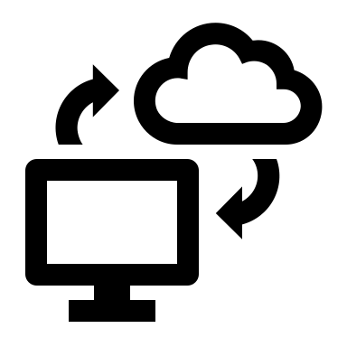


Development Flow
GitHub
IDE
Jenkins
Docker
Development PC(s)
Raspberry Pi(s)

Slide 9
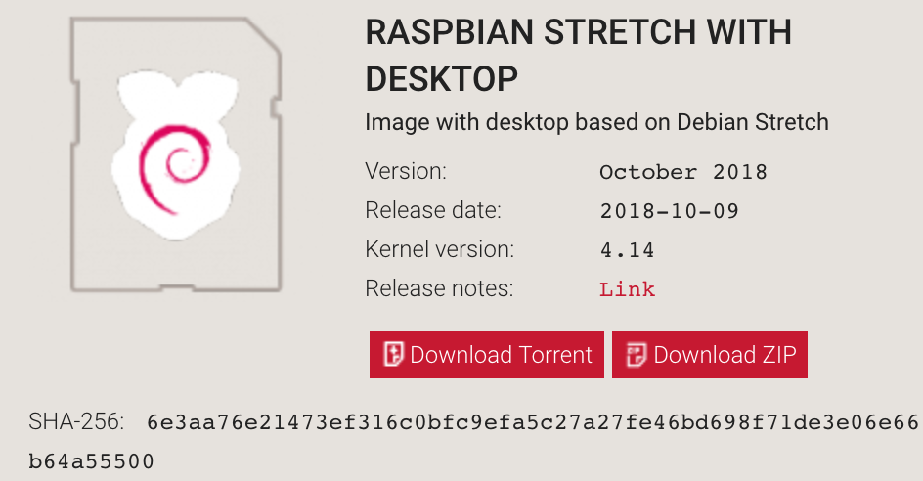
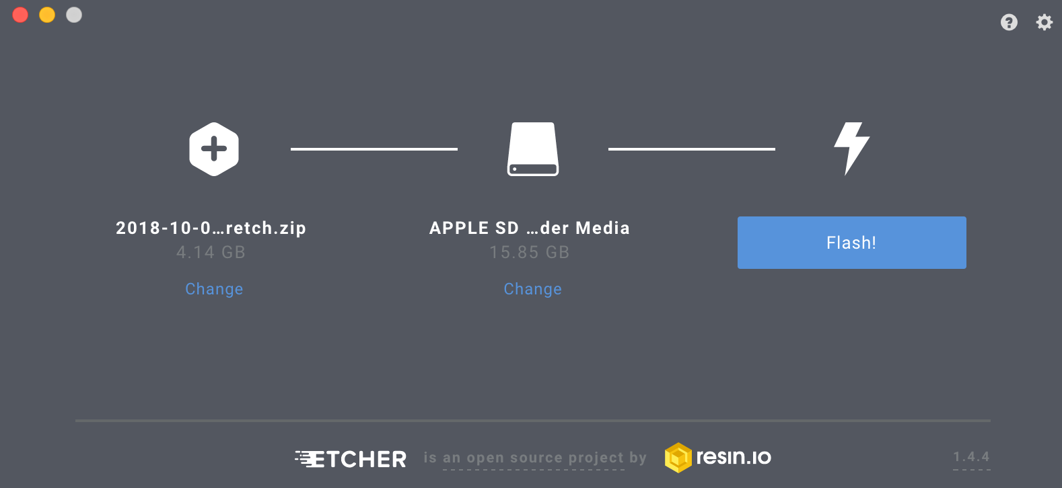
Getting started with Pi – Install the OS
We’ll assume you have a keyboard, mouse and monitor
Get a Pi3B+, 8+ gig Class 10 MicroSD memory card, 2.5A micro USB power supply and HDMI cable. Optionally splurge on a 7” touch display, stand and camera
Download an OS image and write it to MicroSD
Raspbian: https://www.raspberrypi.org/downloads/raspbian/
Follow https://www.raspberrypi.org/documentation/installation/installing-images/README.md
Insert card into your Pi, attach a monitor, keyboard and mouse, and power it up!
Default credentials are “pi” and “raspberry”

Slide 10
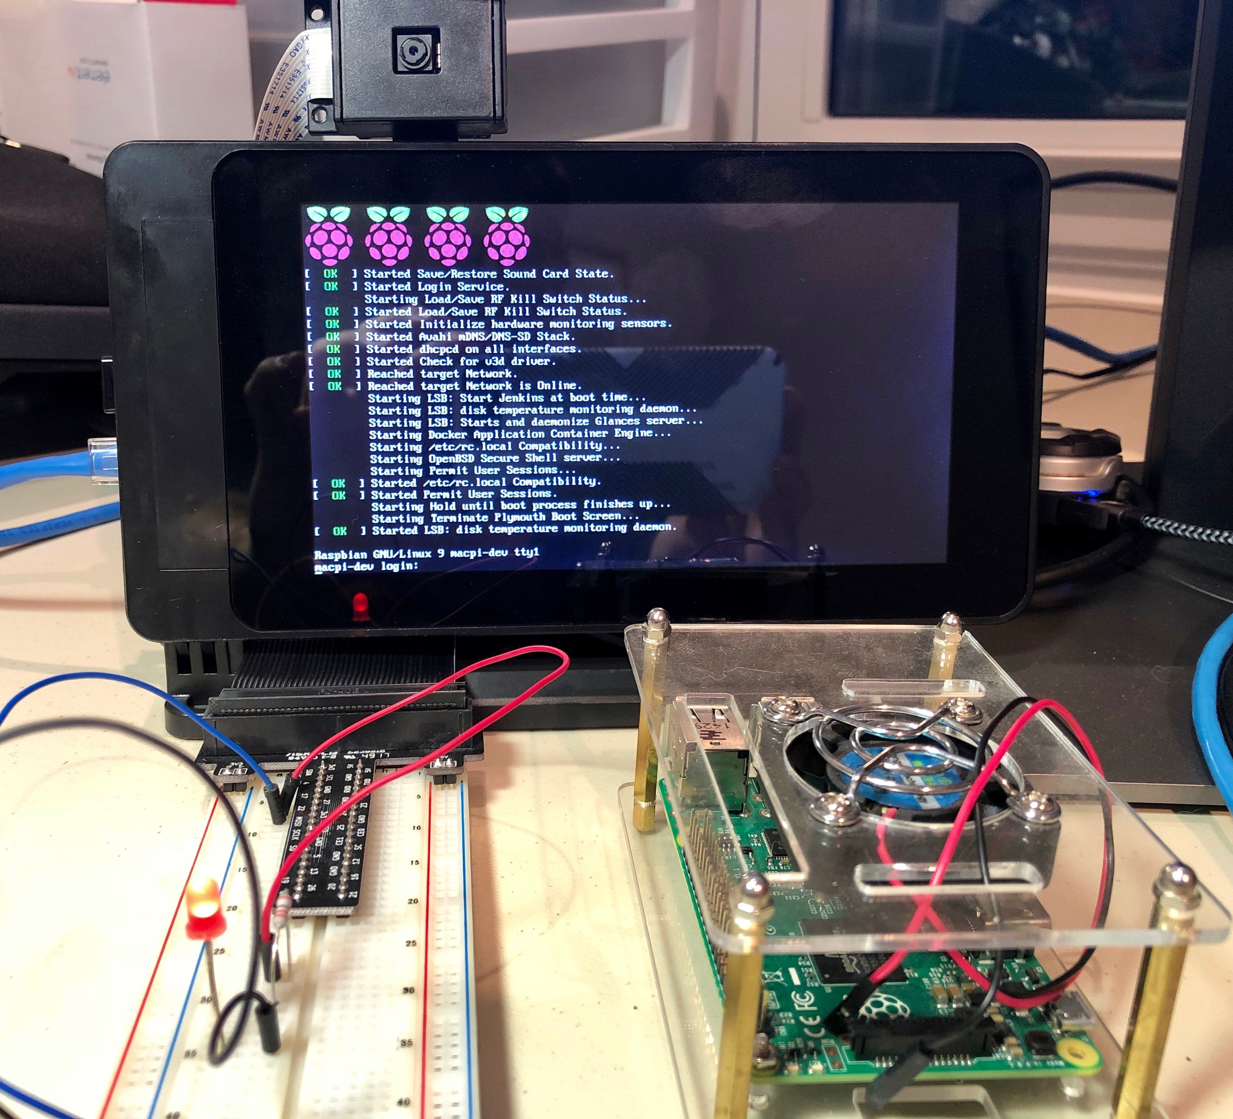
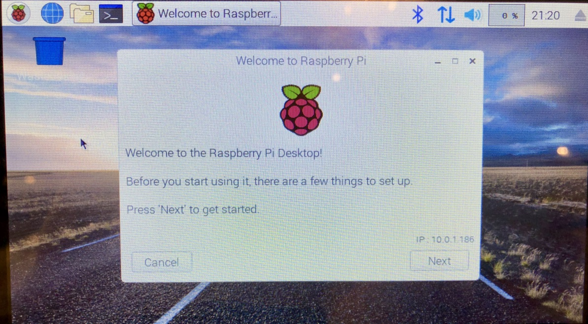
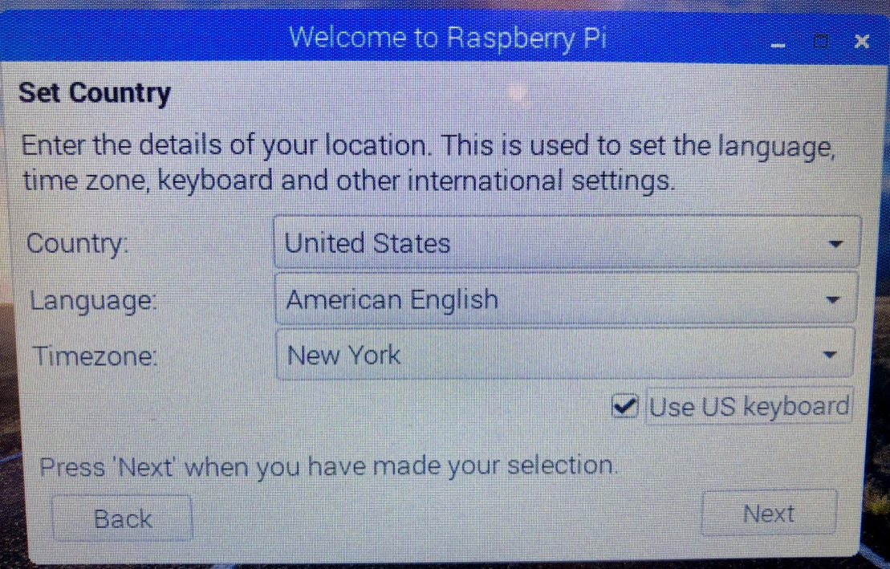
Configure Raspbian
Menu > Preferences > Raspberry Pi Configuration (X GUI) or type raspi-config (command line GUI)
Change password
Change hostname
Check boot to CLI (optional)
Uncheck auto-login as user “pi” (optional)
Check enable Camera, SSH, SPI and I2C
Set locale, time zone and keyboard
Reboot and login as user “pi” with password specified above

Slide 11
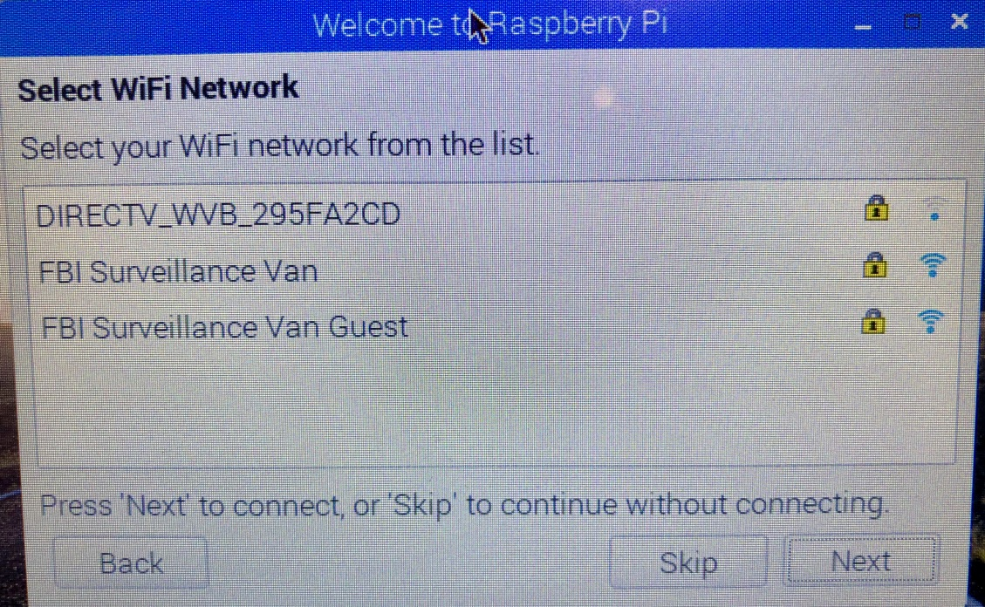
Configure Networking
Wired networking is ideal, but Wi-Fi works great too
Type startx and right-click the network icon in the upper right
Select WiFi Network Settings
Configure SSID for the desired network
Leave “Automatically configure empty options” checked and click Apply
Left-click the network icon and select desired network, then enter password
Confirm Internet access using “sudo ping google.com" and the browser
Record IP address (i.e. 192.168.1.96)
Verify connectivity, i.e. connect to the RPi from another workstation via SSH

Slide 12
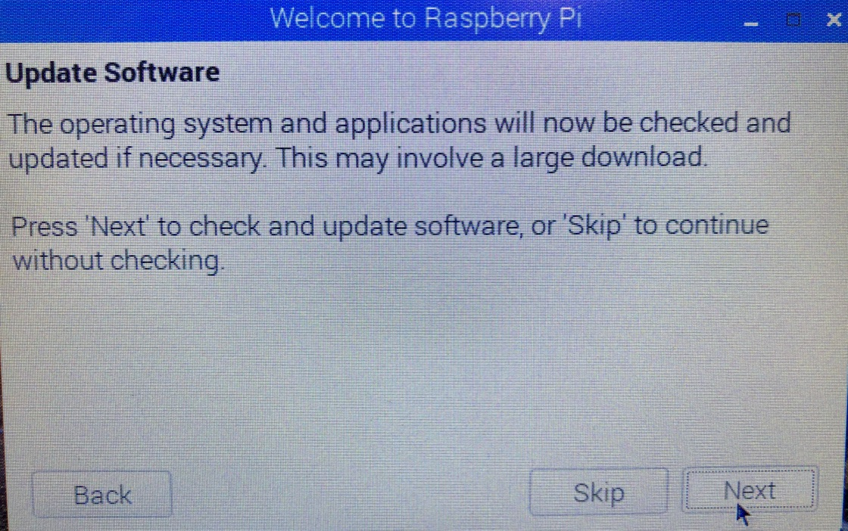
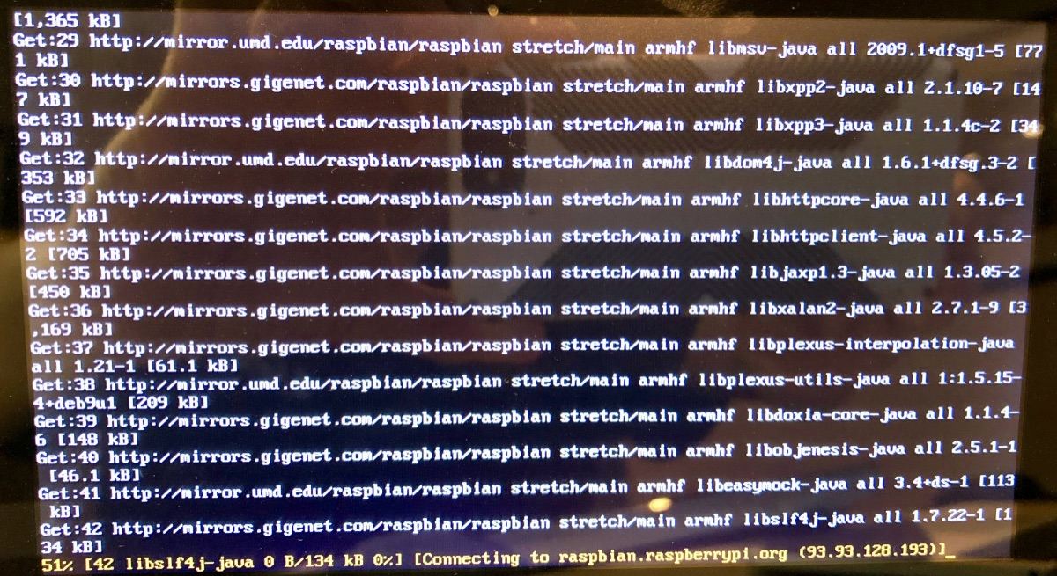
Update packages, Install Java and Maven
Continue with the Raspbian wizard and reboot
Java JDK should already be installed; confirm with “java -version“. If not, use “sudo apt install oracle-java8-jdk –y”
Install Maven with “sudo apt install maven” and confirm with “mvn --version“
Install Glances (prettier than top) with “sudo apt install glances” and confirm with “glances” (“q” to quit)
Install lsof with “sudo apt install lsof”

Slide 13
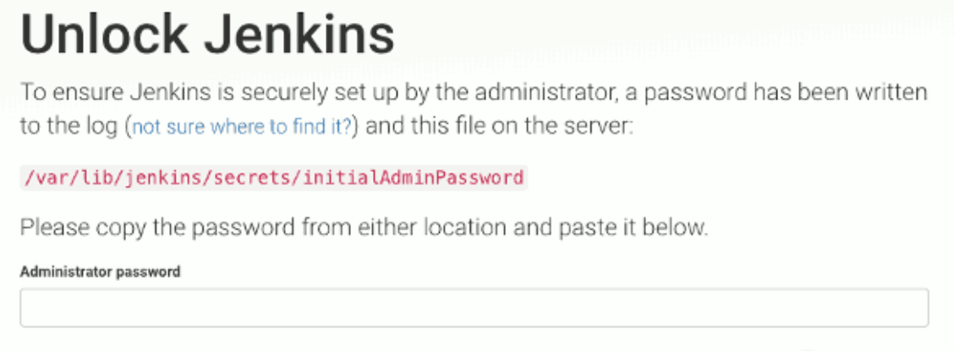
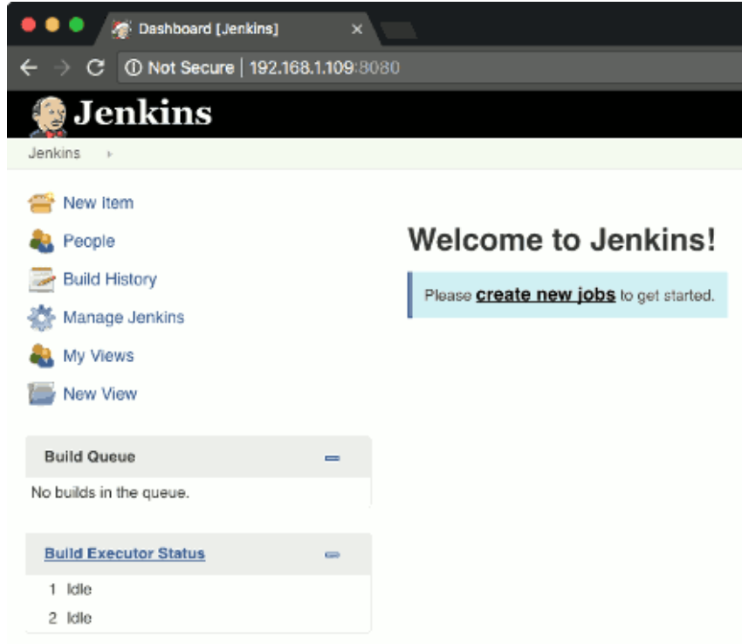
Install Jenkins
Install latest Jenkins version
wget -q -O - https://jenkins-ci.org/debian/jenkins-ci.org.key | sudo apt-key add -
sudo sh -c 'echo deb http://pkg.jenkins-ci.org/debian binary/ > /etc/apt/sources.list.d/jenkins.list'
sudo apt update
sudo apt install jenkins –y
sudo adduser jenkins gpio (also add to sudo, i2c, spi and kmem)
sudo visudo and add “jenkins ALL=(ALL) NOPASSWD: ALL”
Test service installation with “systemctl status jenkins.service”
After a couple minutes, access http://localhost:8080
Unlock Jenkins by pasting the password found at the specified path
Skip plugins and proxy and create first admin user
Change Jenkins > Plugin Manager > Advanced > Update Site to http://updates.jenkins.io/update-center.json (no https)
Add Pipeline, Git, Maven and Docker plugins
Go to Jenkins > Global Tool Configuration and add Java and Maven installations (ok to use the ones we just installed)

Slide 14
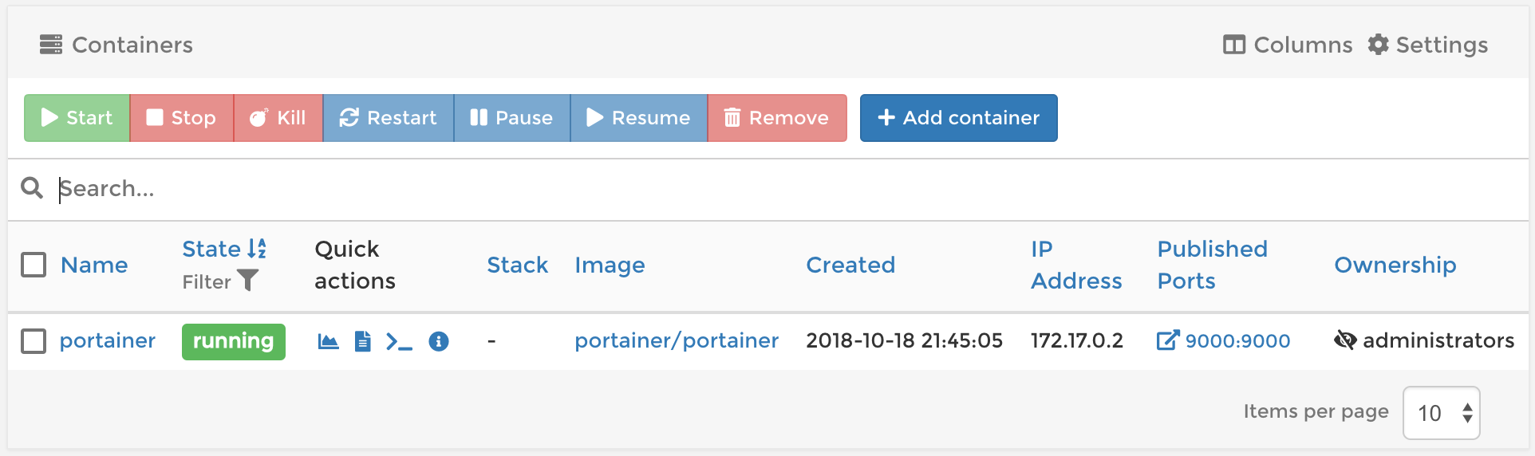
Install Docker and Portainer
Install Docker’s container manager
curl -fsSL get.docker.com -o get-docker.sh && sh get-docker.sh
Test with “sudo docker ps”
Install Portainer as your first container – it’s really helpful!
sudo docker volume create portainer_data
sudo docker run -d -p 9000:9000 --name portainer --restart always -v /var/run/docker.sock:/var/run/docker.sock -v portainer_data:/data portainer/portainer
Browse at http://localhost:9000

Slide 15
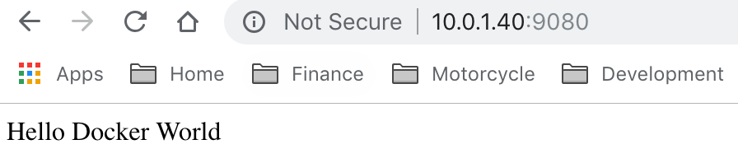
Test Docker with Spring Boot and Jenkins
Let’s start with a pre-made recipe…
Add a job named “gs-spring-boot-docker” of type “Pipeline”
Pipeline script:
node {
stage ("Git Clone") {
git 'https://github.com/spring-guides/gs-spring-boot-docker.git'
}
stage ("Compile and Test") {
sh "sudo mvn -f complete/pom.xml clean package"
}
stage ("Docker Image Build") {
sh "sudo mvn -f complete/pom.xml dockerfile:build -DskipTests=true"
}
stage ("Stop and Remove Existing Containers") {
sh "sudo docker stop gs-spring-boot-docker || true"
sh "sudo docker rm gs-spring-boot-docker || true"
}
stage("Run Refreshed Container") {
sh "sudo docker run -d --restart=always -p 8001:8001 -p 9080:9080 --name gs-spring-boot-docker gs-spring-boot-docker:0.1.10"
sh "echo 'A running gs-spring-boot-docker container should soon be available for remote debugging on port 8001.'"
}
}
Click Save and Build Now
User “sudo docker ps”, “docker logs xxx” and Portainer to examine status
Check out http://localhost:9080 with your browser

Slide 16
Pi4J LED Control Example
Wire up the General Purpose Input/Output (GPIO) Pin #1 to an LED
Create a class with a Main method:
public class ControlGpioExample {
public static void main(String[] args) throws InterruptedException {
// create gpio controller and provision pin #01 as an output pin; turn on
final GpioController gpio = GpioFactory.getInstance();
final GpioPinDigitalOutput pin = gpio.provisionDigitalOutputPin(RaspiPin.GPIO_01, "MyLED", PinState.LOW);
// turn on gpio pin #01
pin.high();
System.out.println("--> GPIO state should be: ON");
Thread.sleep(5000);
// turn off gpio pin #01
pin.low();
System.out.println("--> GPIO state should be: OFF");
Thread.sleep(5000);
// stop all GPIO activity/threads by shutting down the GPIO controller
gpio.shutdown();
}
}
Note: Newer pinouts are different

Slide 17
Pi4J Button Example
Wire up the General Purpose Input/Output (GPIO) Pin #2 to a button
public class ListenGpioExample {
public static void main(String args[]) throws InterruptedException {
// create gpio controller & provision gpio pin #02 as input with internal pull down resistor
final GpioController gpio = GpioFactory.getInstance();
final GpioPinDigitalInput myButton = gpio.provisionDigitalInputPin(RaspiPin.GPIO_02, PinPullResistance.PULL_DOWN);
// create and register gpio pin listener
myButton.addListener(new GpioPinListenerDigital() {
@Override
public void handleGpioPinDigitalStateChangeEvent(GpioPinDigitalStateChangeEvent event) {
// display pin state on console
System.out.println(" --> GPIO PIN STATE CHANGE: " + event.getPin() + " = " + event.getState());
}
});
// keep program running until user aborts (CTRL-C)
for (;;) {
Thread.sleep(500);
}
gpio.shutdown();
}
}
Note: Newer pinouts are different

Slide 18
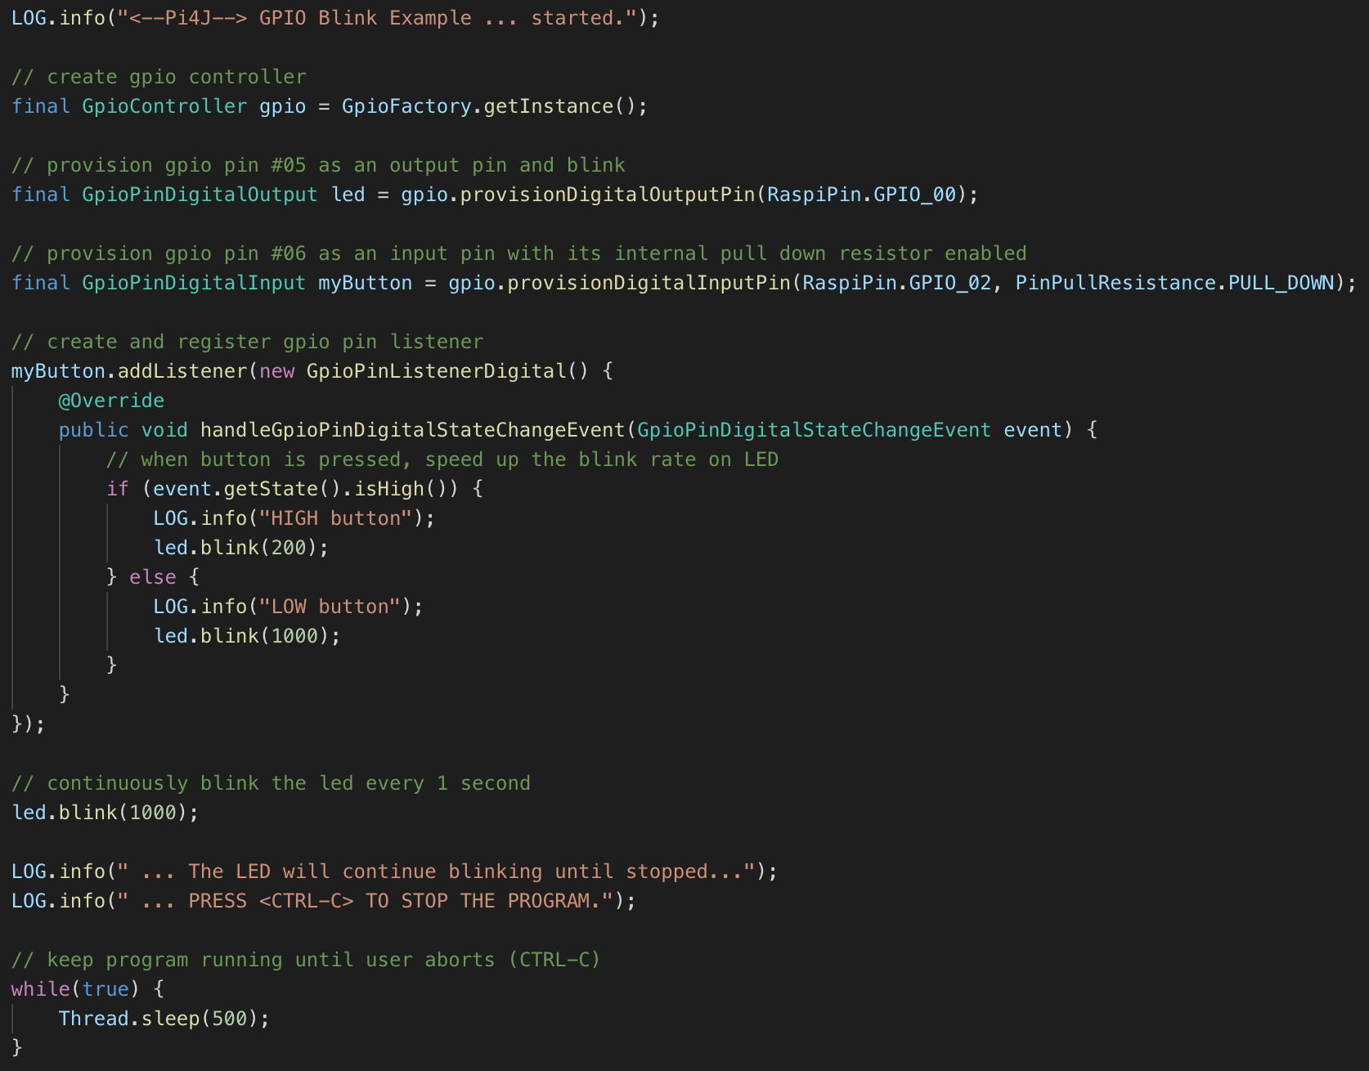
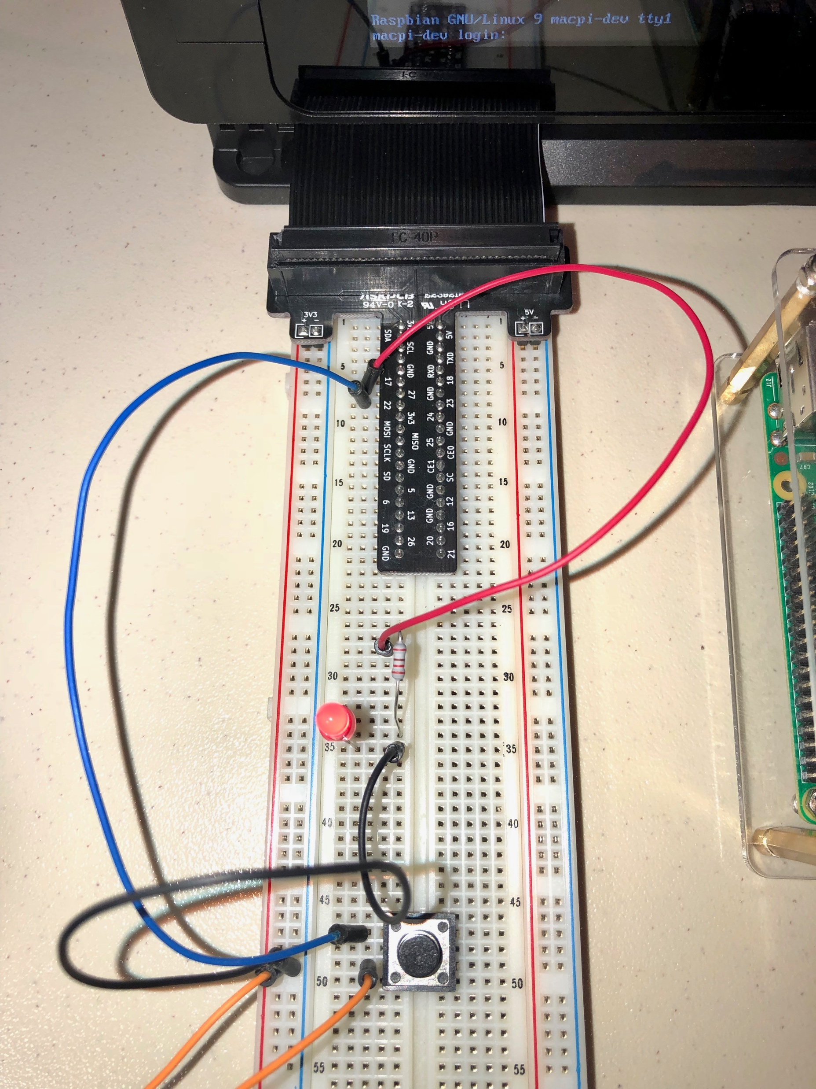
Combined “pi4jdemo” example

Slide 19
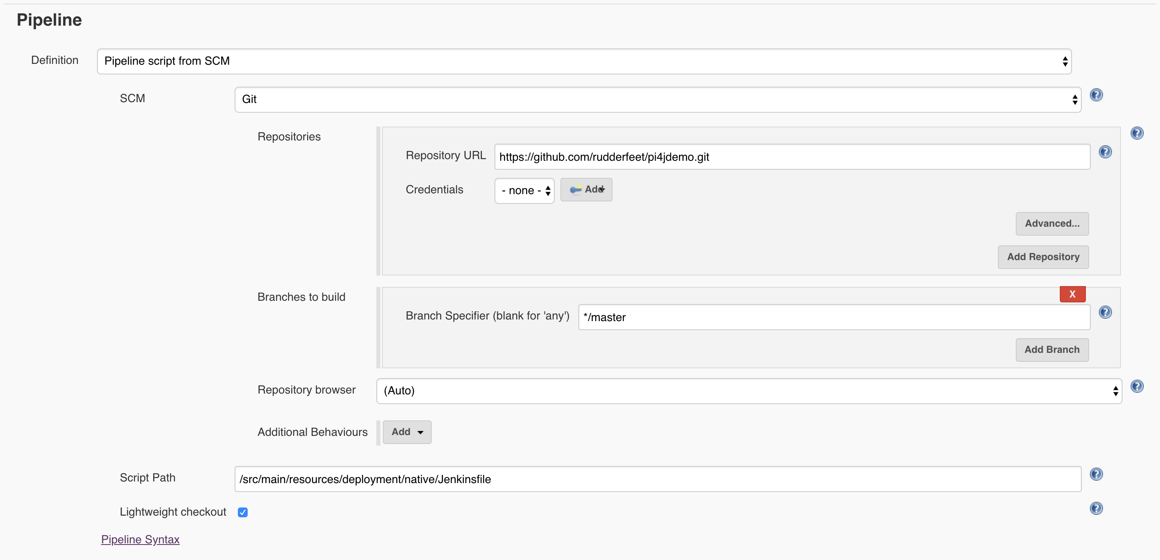
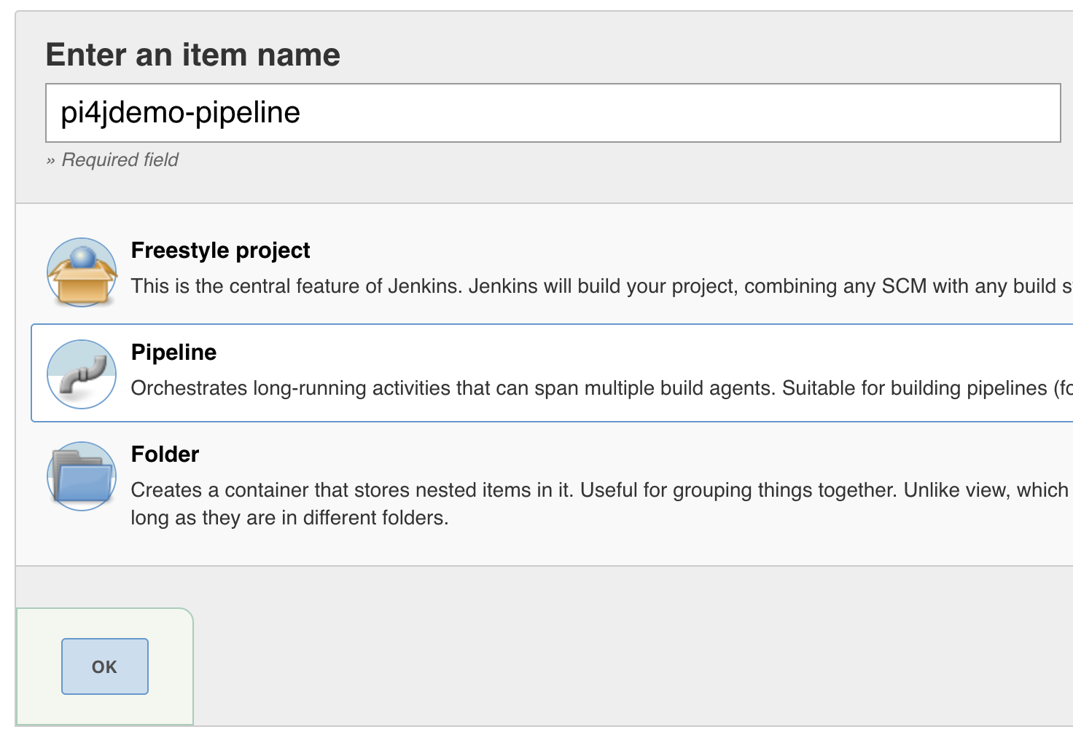
Test combined pi4jdemo “natively” with Jenkins
Let’s start with a pre-made recipe…
Add a job named “pi4jdemo-pipeline” of type “Pipeline”
Specify: Pipeline script from SCM
Repository URL: https://github.com/rudderfeet/pi4jdemo.git
Script Path: src/main/resources/deployment/native/Jenkinsfile
Click Save and Build Now
Behold the blinking lights!

Slide 20
Java, Jenkins, Docker and Pi Dev Tips
Develop Java any way you want using Eclipse/VS Code/etc.
Use Git with Jenkins to pull down updates to the Pi
Place Pi-specific unit tests into their own build profiles which run only on the Pi
Docker containers can’t access WiringPi hardware support, so run those ”natively”
Spring Boot Web apps can take several minutes to containerize and start - be patient!
Embrace incremental learning – get small basics to work then build upon them
Pi4J docs are at http://pi4j.com/; Note that Pi4j/WiringPi pin numbers are different from most breakout boards – see http://pi4j.com/pins/model-3b-rev1.html
Debug with gpio utility described at http://wiringpi.com/the-gpio-utility/
See https://github.com/Pi4J/pi4j/tree/master/pi4j-example/src/main/java for popular pi4j hardware chip support, I2C, SPI, GPSes, ADCs, DACs, temp and humidity probes, etc.

Slide 21
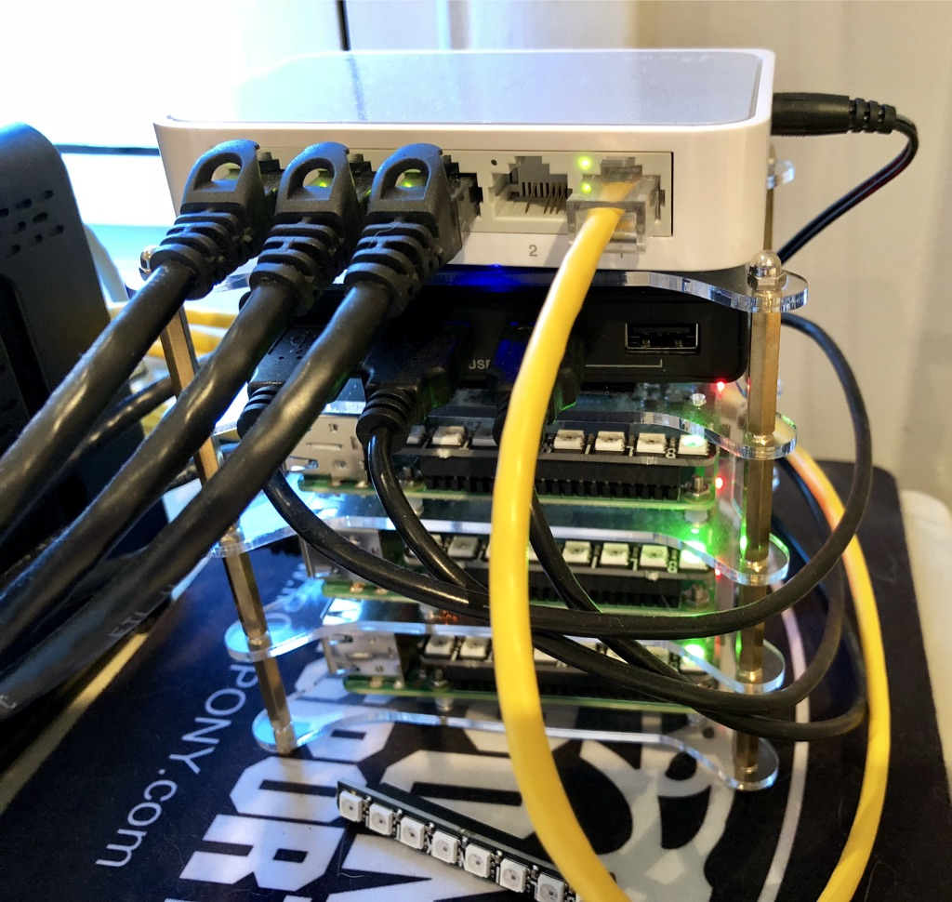
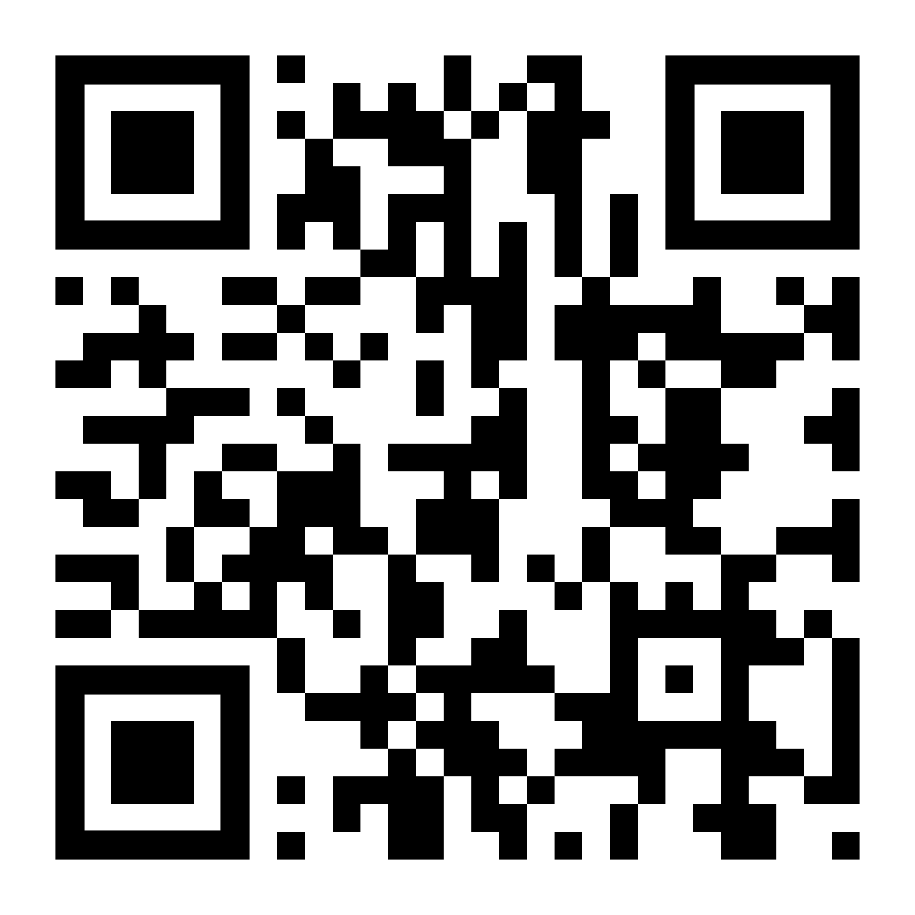
Thank you!
Remember that things like Maven, Spring Boot and embedded Tomcat can be easily deployed to the Pi, just like a corporate web application or middleware
The possibilities are endless - server-side embedded Tomcat running Spring Boot connecting to MySQL, announcing to Twitter, graphing to Plot.ly, posting to Facebook, dropping messages to MQ, calling REST and SOAP APIs, measuring voltages, controlling relays, display panels and lights, gathering coordinates, taking pictures, learning about clustering and more!
Pi4jdemo source code: https://github.com/rudderfeet/pi4jdemo
Scott McCrory – scott@mccrory.us

